Slide 1
EMAIL MESSAGE FORMAT (MIME)
Kyrshanlang Dkhar-01
Nangwadborlang Marngar-15
Group-4
Mca/4th sem

Slide 2
CONTENT
Introduction
Background
MIME Headers
Email Security
Conclusion

Slide 3
INTRODUCTION
In 1992, a new standard was defined by an Internet Engineering Task Force Working Group - called MIME.
MIME is a specification for enhancing the capabilities of standard Internet electronic mail.
MIME stand for Multipurpose Internet Mail Extensions .

Slide 4
When using the MIME standard, messages can contain the following types:
Character sets other than US-ASCII.
Multi-media: Image, Audio, and Video messages.
Multiple objects in a single message.
Multi-font messages.
Messages of unlimited length.
Binary files.

Slide 5
MIME is defined to be completely backwards compatible, yet flexible and open to extensions. Therefore, it builds on the older standard by defining additional fields for the mail message header, that describes new content types, and a distinct organization of the message body.

Slide 6
Background
SMPT ( Simple Mail Transfer Protocol ) is widely used around the world, it is the standard protocol for transferring mail between hosts in the TCP/IP suite.
However, SMPT has been limited to the delivery of simple text messages which does not meet the rising demand for capability of delivery mail containing various types of data, including voice, images and video clips.
To satisfy this requirement, a new electronic mail standard, which builds on SMPT, has been defined.

Slide 7
Limitations of the SMPT scheme
The message may contain only US-ASCII characters
The maximum line length allowed is 1000 characters
The message must not be longer than a predefined maximum size
Cannot transmit executable files or other binary objects.
It cannot transmit text data that includes national language characters ( 8-bit codes) because it is limited to 7-bit ASCII.
SMPT servers may reject mail message over a certain size.
SMPT gateways that translate between ASCII and the Character code EBCDIC do not use a consistent set of mappings, resulting in translation problems.

Slide 8
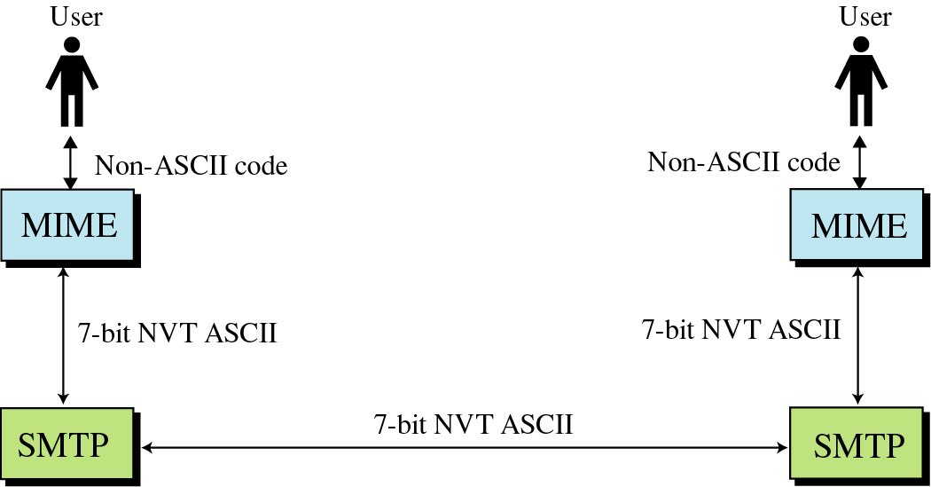
Solution: SMTP extensions
MIME – Multipurpose Internet Mail Extensions
Transforms non-ASCII data to NVT (Network Virtual Terminal) ASCII data
Text
Application
Image
Audio
Video

Slide 9
MIME Headers
Located between the Email Header and Body
MIME-Version: 1.1
Content-Type: type/subtype
Content-Transfer-Encoding: encoding type
Content-Id: message id
Content-Description: textual explanation of non-textual contents

Slide 10
MIME Headers(Contd.)
Here is a summary of the different MIME content types:
Type
Subtype
Description
Text
Plain
Enriched
Unformatted text (ASCII or ISO 8859).
Provides greater format flexibility.
Multipart
Mixed
Parallel
Alternative
Digest
The different parts are independent but are to be transmitted together. Should be presented to the receiver in their original order.
Differs from mixed only in that no order is defined.
The different parts are alternative versions of the same information.
Similar to Mixed but the default type/subtype of each part is message/rfc822.
Message
rfc822
Partial
External body
The body is itself an encapsulated message that conforms to RFC822.
Used to allow fragmentation in a transparent way to the recipient.
Contains a pointer to an object exists else where.

Slide 11
MIME Header(contd.)
Type
Subtype
Description
Image
Jpeg
gif
The image is in JPEG format.
The image is in GIF format.
Video
Mpeg
MPEG format.
Audio
Basic
Single-channel 8-bit ISDN mu-law encoding at a sample rate of 8kHz
Application
Postscript
Octet-stream
Adobe Postscirpt.
General binary data consisting of 8-bit bytes.

Slide 12
MIME Header(contd.)
The other major component of MIME is a definition of transfer encodings for message contents:
Encoding
Description
7bit
The data are all represented by short lines of ASCII chars.
8bit
The lines are short, but there may be non-ASCII chars.
Binary
Not only may non-ASCII chars be presented but lines are not necessarily short enough for SMTP transport.
Quoted-printable
Encodes the data in such a way that if the data being encoded are mostly ASCII text, the encoded form of the data remains largely recognizable by humans.
Base64
Encodes data by mapping 6-bit blocks to 8-bit printable ASCII characters blocks.
x-token
A nonstandard encoding.

Slide 13
Base64 Encoding
Divides binary data into 24 bit blocks
Each block is then divided into 6 bit chunks
Each 6-bit section is interpreted as one character, 25% overhead
11001100 10000001 00111001
110011 001000 000100 111001
(51)
(8)
(4)
(57)
(z)
(I)
(E)
(5)
01111010
01001001
01000101
00110101

Slide 14
Quoted-Printable Encoding
Used when the data has a small non-ASCII portion
Non-ASCII characters are sent as 3 characters
First is ‘=‘, second and third are the hex representation of the byte
01001100 10011101 00111001
(=)
(9)
(D)
00111101
00111001
01000100

Slide 15
Types of electronic mail security
Pretty Good Privacy
S/Mime

Slide 16
Pretty Good Privacy
Developed almost entirely by Phil Zimmerman
Free, worldwide, works across a variety of platforms.
Based on known algorithms such as RSA

Slide 17
Authentication
The steps for authentication are as follows
The sender creates a message
SHA-1 is used to generate 160-bit hash code
Hash code is encrypted with RSA using senders private key
Receiver uses RSA to decrypt the hash code
Receiver generates a new hash code and compares with the decrypted one

Slide 18
Confidentiality
The steps to obtain confidentiality are as follows
The sender generates a message and a random 128-bit number called the session key
The message is encrypted with CAST-128
The session key is encrypted with recipients’ public key using RSA
The recipient uses RSA with its private key to decrypt the session key
The session key decrypts the message

Slide 19
Confidentiality and Authentication
To have both confidentiality and authentication
The sender first signs the message using it’s own private key
Then encrypts the message with the session with the session key
Then encrypts the session key with the recipient’s private key

Slide 20
Compression
PGP compresses files using a ZIP algorithm
The signature is generated before compression
To store the uncompressed message with the signature
Would interfere with compression because of multiple compression algorithms exist.
Message encryption is after compression
To strengthen cryptographic security, as it reduces redundancy

Slide 21
Compatibility
E-mail sends only ASCII characters
Because of this PGP converts message to ASCII
Converts three octets into four ASCII characters
Expands message by 33%
After compression, there is a net reduction by a third

Slide 22
Segmentation and Reassembly
Some mail providers impose a maximum length of 50,000 octets
PGP will automatically subdivide any message too large into small enough segments to send via e-mail
This is done after all other processing

Slide 23
Cryptographic Keys
PGP uses four types of keys
Session keys
Public keys
Private Keys
Passphrase keys

Slide 24
Cryptographic Keys
Three requirements for the keys
Needs a mean of generating unpredictable session keys
Would like a way to allow each user to have multiple public/private key pairs
Maintain a file of the public/private key pairs

Slide 25
Session Key Generation
Random 128-bit numbers are generated using CAST-128
Input to the number generator takes in is a 128-bit key and two 64-bit blocks of plaintext.
Input is determined by keystrokes and the times the keystrokes are made
Input is also effected by previous key outputs

Slide 26
Key identifiers
With multiple private/public key pairs, there needs to be a way for the receiver to know which to use
How this is done is through the combination of a 64 bit key ID, which is unique to a user ID.
With this key ID, the receiver can retrieve the correct public key of the sender to decrypt the message.
A list of these key ID’s are placed in what is called a key ring.

Slide 27
Key Rings
There are both public and private key rings
A user needs a passphrase key in order to retrieve a private key, or to encrypt with a private key
When creating a private key
The user selects the passphrase to be used
The system generates a new public/private key pair using RSA, and using SHA-1 a 160-bit hash code is generated from the passphrase
The system encrypts the private key using CAST-128 with the 128 bits of the hash code of the key and then the hash code is discarded

Slide 28
Key Ring – Signing the message
PGP retrieves sender’s private key using user-id as an index.
PGP prompts the user for the passphrase to recover unencrypted private key
Constructs signature component of the message

Slide 29
Key Ring – Encrypting the Message
PGP generates session key and uses it to encrypt the message
PGP retrieves the recipient’s public key from it’s public-key ring using their user ID as an index
The session key of the message is constructed

Slide 30
Key Ring – Decrypting the Message
PGP retrieves the receiver’s private key from the private-key ring using the key ID in the session key component of the message as an index
PGP prompts the user for the passphrase to recover the unencrypted private key
PGP recovers the session key and decrypts the message.

Slide 31
Key Ring – Authenticating the Message
PGP retrieves the sender’s public key from the public-key ring using the key ID from the signature portion of the message as an index.
PGP recovers the transmitted message digest
PGP computers the message digest for the received message

Slide 32
The Use of Trust
Each public-key ring has a signature and a signature trust entry for each public key
This entry indicates the degree the PGP user trusts the signer to certify public keys.
Each public-key ring has a owner trust field
This entry indicates the degree to which the public key is trusted to sign other public key certificates.

Slide 33
S/MIME
Stands for Secure/Multipurpose Internet Mail Extension
Security enhancement to the MIME internet e-mail format

Slide 34
S/MIME Functionality
S/MIME provides the following functions
Enveloped Data
Consists of encrypted content of any type of encrypted content encryption keys
Signed Data
Contains a digital signature
Clear-signed data
Encoded digital signature
Signed and enveloped data
Encrypted and Signed data

Slide 35
S/MIME – Cryptographic Algorithms
Create message digest to form digital signature
Must use SHA-1, Should support MD5
Encrypt message digest to form signature
Must support DSS, Should support RSA
Encrypt session key for transmission
Should support Diffie-Hellman, Must support RSA

Slide 36
S/MIME – Cryptographic Algorithms
Encrypt message for transmission with one-time session key
Must support triple DES, Should support AES, Should support RC2/40
Create a message authentication code
Must support HMAC with SHA-1, Should support HMAC with SHA-1

Slide 37
S/MIME – User Agent Role
Key generation
Generating key with RSA
Registration
Register a user’s public key must be registered with a certification authority
Certificate storage and retrieval
Access to a local list of certificates in order to verify incoming signatures and encrypt outgoing

Slide 38
S/MIME – Enhanced Security Services
Signed receipts
The receiver returns a signed receipt back to the sender to verify the message arrived
Security labels
Permission, priority or role of message being sent
Secure mailing lists
Sending to multiple recipients at once securely by using a public key for the whole mailing list

Slide 39
Conclusions
MIME is a necessity in today’s Internet and e-mail traffic requirements.
The “Object Oriented” structure of the MIME message enhances its capability to serve as multipurpose standard.
The MIME is capable of transferring data between two distinct systems which uses different formats

Slide 40
THANK YOU

